Slide 1
Reimagining Financial Digital Accessibility with Artificial Intelligence Agents
Bhanu Arya
Panos Papaeconomou

Slide 2
Executive Summary
What? Democratizing AI-powered financial services to ensure accessibility for all users.
Why? Increased WCAG compliance. Improved compliance with Consumer Duty standards. Improved Bank’s customer engagement and satisfaction. Increased customer acquisition and retention. Reduce customer service cost.
How? An AI agent, that solves accessibility customer challenges across the organization.

Slide 3
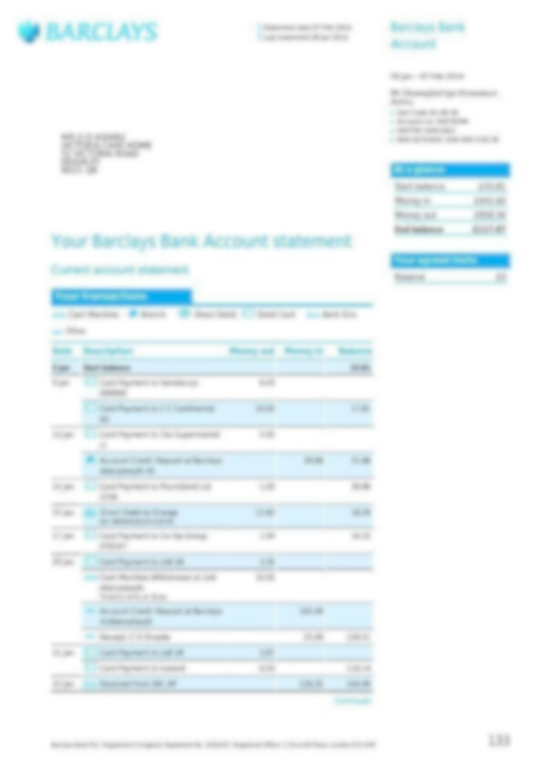
What is the account balance, please?
This is how it may look for people with Visual disability

Slide 4



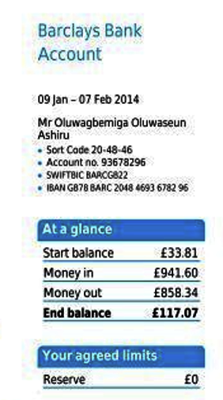
Visual assistance using AI screen reader
What is the account balance?
The current account balance is £117.07

Slide 5
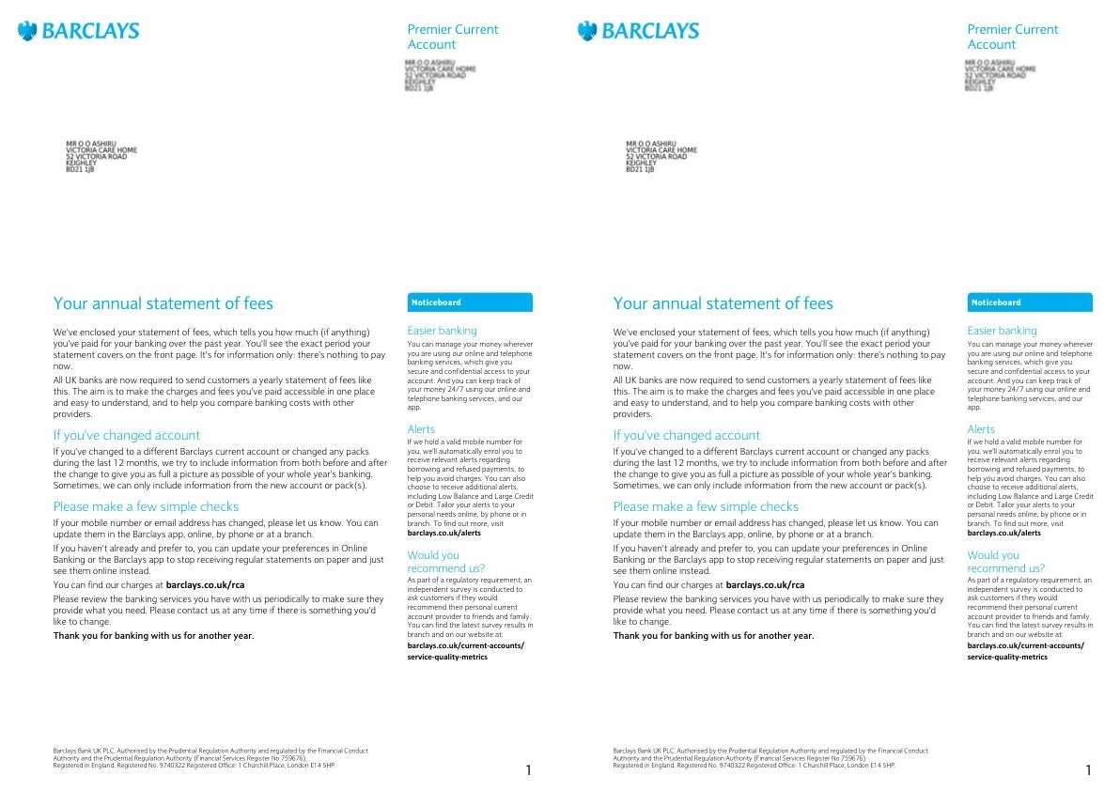
How long will it take to read this? Manually or Screen Reader
How long will it take to understand ?

Slide 6
Engaging and Fast Cognitive assistance
What are the changes? Summarize
<< Responds in seconds >>
**Changes to Barclays Current Account**
Barclays has made several changes to its current account, including:
* **No Paper Statements**: Barclays will no longer provide paper statements for their customers. Instead, they will offer an online service where customers can view and download their statements.
* **Alerts**: Customers will be able to set up alerts to notify them of various transactions on their accounts.
The document contains approximately 621 words. A screen reader would take about 207 seconds (or roughly 3 minutes and 27 seconds) to read it aloud at an average speed of 180 words per minute.
AI Accessibility agent does that in seconds.

Slide 7
Proposed Solution – AI Accessibility Agent
Content Simplification:
Simplify financial technical information
- Translate the content to different language
App Navigation:
Assist in doing task in app or web by voice or text command
Personalization:
personalized recommendation relevant to the user
Customization of UI based previous user interactions
Customization of content based on user interactions and preferences
Accessibility Enhancements:
real-time text-to-speech
Auditing: ensuring accessibility compliance of software
E.g., Verification – HTML code review for accessibility e.g., suggesting suitable alt text for image.
Reporting and Visualization – for apps, customer portals for accessibility across websites
E.g., Changing address in the app
E.g., For Bank statements - How much did I spend this month?
- Simplify technical financial language
- Summarize long statements
E.g., Budget planning
E.g., Understanding and Translate different languages. French < > English
Converting speech-to-text including - Disfluent Speech understanding (people having difficulty speaking)
Visual recognition systems:
to assist the visually impaired in understanding content easily
Interactive Voice or Speech based interaction
Much better than screen readers !

Slide 8

Demo

Slide 9
Why it makes sense to invest?
1.3 billion people globally live with some form of disability (Source: WHO, 2023)
$13 trillion in annual disposable income in the disability market (Source: Return on Disability Group, 2023)
85% of banks identify AI as a strategic priority (Source: Deloitte Banking Survey, 2023)
Voice-enabled banking: 35% increase in user engagement (Source: Fidelity Voice Banking Study, 2023)
Multi-language support: 28% increase in user adoption (Source: Financial Inclusion Global Initiative, 2023)
Adaptive interfaces: 45% improvement in task completion rates (Source: Accessibility Banking Forum, 2023)
Market Opportunity
Solution Space

Slide 10
FAQs
What are direct benefits?
It will lead a BIG increase customer engagement
Move improve Bank apps from WCAG AA ratings
Additional points for Consumer Duty Guidelines – treating all customers fairly and equally.
First of its kind – you an be pioneer in implementing such AI accessibility solution – Marketing!
Cross sell and up sell – because the solution can be personalized with user interaction, it will enable precise cross sell and up sell opportunities
How can I offset risks with AI Accessibility?
Incremental features development - so you control
Guardrails – ensure that input and output data is validated before it reaches customer
Audit trail and through testing – monitor and continuously improve
What are indirect benefits?
Reduce customer care load – AI simplifies
Strategically create edge in creating future applications leveraging this infrastructure
How it different from ChatGPT?
It understands and does things based on interaction.
Similar > Large Language Model based solution
Different > Customized architecture trained to assist in accessibility requirements

